Slide 1

Chapter 4
Polymorphism in PHP (OOP)
ITP03 | 1ST SEMESTER

Slide 2
Learning Objectives
1. Explain and implement polymorphism using a common base class.

Slide 3
What is Polymorphism?
Polymorphism means one interface, many behaviors.
Different classes can implement the same method name differently.
Achieved through method overriding.
Polymorphism = "Many Forms"

Slide 4
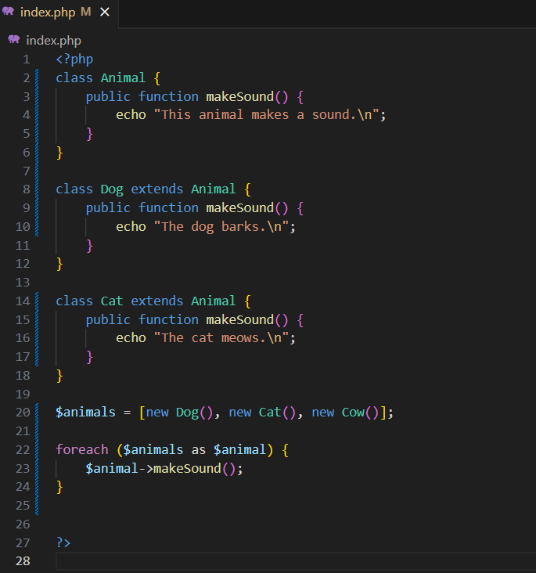
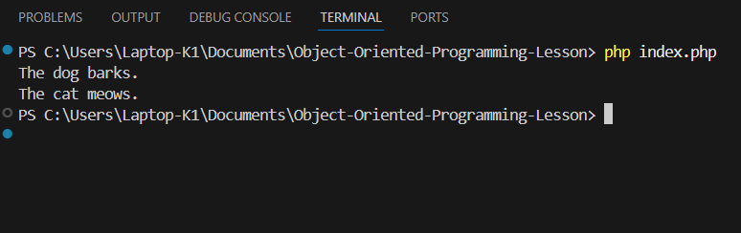
Syntax

